Slide 1

Git & GitHub
DISTRIBUTED VERSION CONTROL & GLOBAL COLLABORATION
A Guide to Git & GitHub
By: Sarthak Patani
Atharva Deshmukh

Slide 2
Section 01
Git: The Local Powerhouse

Slide 3

What is Git?
The Engine of Version Control
Git is a Distributed Version Control System (DVCS) created by Linus Torvalds. Unlike older systems, every developer has a full copy of the project history locally.
Blazing fast local operations.
Powerful branching and merging.
Cryptographic data integrity.

Slide 4
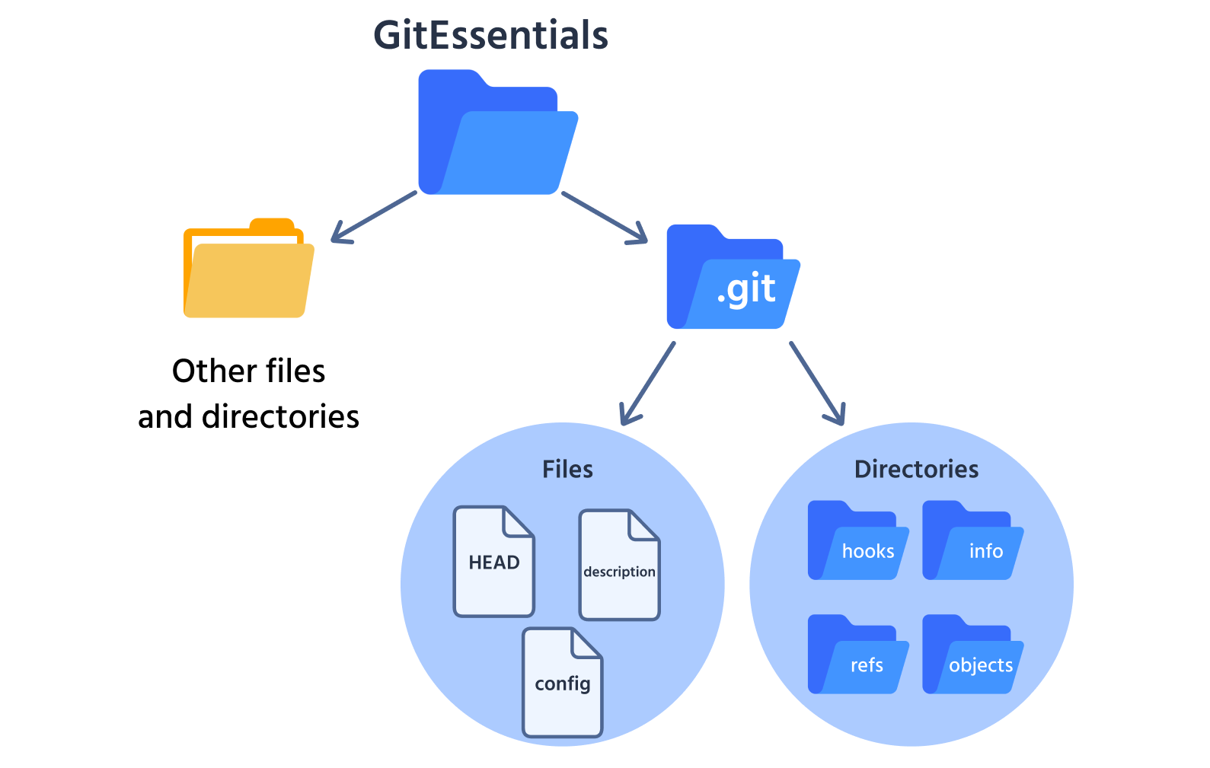
Local Storage: The .git Folder
Where the Magic Happens
When you run git init, a hidden directory called .git is created. This is your project's local database.
Inside the .git folder:
Objects: Stores all content (Blobs, Trees, Commits).
Refs: Pointers to your branches and tags.
HEAD: Tracks where you are currently.

Slide 5






The Three States of Git
Working Directory
Staging Area
Repository
The files you are currently editing on your disk. These are "untracked" or "modified".
The index where you prepare files for your next commit. A draft snapshot.
The permanent history stored in the .git directory after a commit.

Slide 6
Section 02
GitHub: The Collaboration Hub

Slide 7
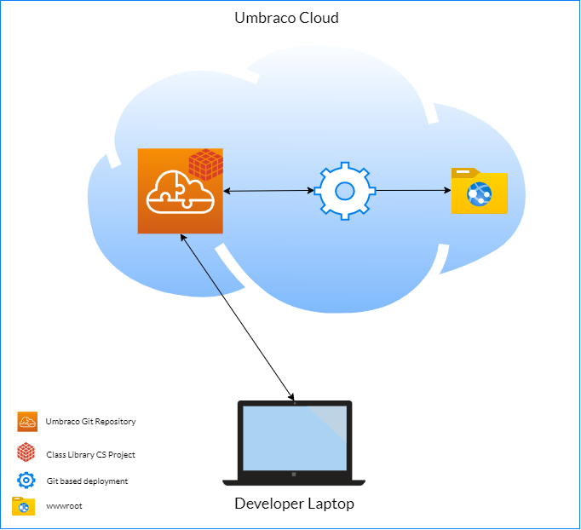
Cloud Repositories
GitHub is a hosting service for Git repositories. It takes the power of Git and adds a social layer for global collaboration.
Think of it as the central server where developers sync their local work to share with the world or their team.
Off-site backup of your code.
Multi-user management.

Slide 8
Beyond Simple Storage
Pull Requests: Propose changes and start discussions before merging code into the main branch.
Forking: Copy any public project to your own account to experiment and contribute back.
GitHub Actions: Automate your workflow with Continuous Integration (CI) and Deployment (CD).
Issue Tracking: Manage bugs and feature requests directly alongside your code.

Slide 9
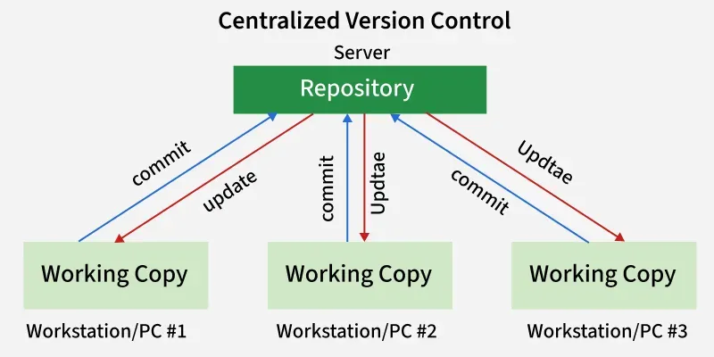
Collaborative Version Control
Parallel Development Without Overwrites
Version control shines when teams collaborate inside GitHub. Instead of sending zipped files back and forth, developers work in absolute sync:
Isolate: Work on features inside separate branches.
Review: Pull Requests enable visual line-by-line code reviews.
Resolve: GitHub flags overlapping edits as merge conflicts, letting you safe-check files before merging.

Slide 10
The Scale of GitHub
100M+
330M+
90%
Active Developers
Total Repositories
Fortune 100 Companies

Slide 11
Section 03
Mastering the Terminal

Slide 12

Setting Up Git Locally
1. Installation
2. Initial Shell Configuration
Before using Git, install it on your PC or desktop operating system:
Tell Git who you are! Every commit is marked with this identity:
Windows: Download and install Git for Windows (which includes Git Bash).
# Set your global commit username $ git config --global user.name "John Doe"
macOS: Open terminal and type git --version to prompt Xcode Command Line Tool install, or use brew install git.
# Set your global email address $ git config --global user.email "john@example.com"
# Confirm setting values $ git config --list
Linux: Run sudo apt install git-all (Ubuntu/Debian) or equivalent package manager command.

Slide 13
The Essential Command Manual
Command | Action | Context
git init | Initialize a new local repo | Start of project
git add . | Stage all current changes | Preparing snapshot
git commit -m "msg" | Save staged changes to history | Local Repository
git push origin main | Send local commits to GitHub | Syncing to Remote
git pull | Fetch and merge remote changes | Updating Local

Slide 14
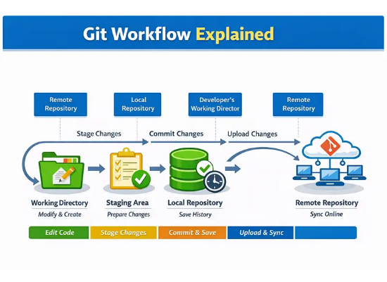
The Complete Workflow
Visualizing the Data Flow
The core of Git/GitHub is the movement of code between these four areas. Understanding this "schematic" is key to resolving conflicts and managing versions.
Pro-Tip: Always git pull before starting work to ensure you are on the latest version!

Slide 15


Your First Repository
Creating a Repository
Creating a Branch
1. Go to GitHub.com & click "New".
1. Use git checkout -b feature-name.
2. Give it a name and description.
2. This creates a separate timeline for your changes.
3. Choose Public or Private.
3. Commits here don't affect the 'main' branch.
4. Clone it locally using git clone [URL].
4. Merge back when your feature is done!

Slide 16



COLLABORATIVE SUB-BRANCHING WORKFLOW
Streamlining multi-developer contributions from isolation to final integration.
Phase | Objective & Description | Terminal Commands
1. SYNC | Get the latest version of main from the cloud. | git checkout main git pull origin main
2. ISOLATE | Create a sub-branch for your specific feature. | git checkout -b feature-name
3. SAVE | Stage and snapshot your progress locally. | git add . git commit -m "Note"
4. UPLOAD | Share your timeline with the team on GitHub. | git push origin feature-name
5. MERGE | Combine your feature back into the main code. | git checkout main git merge feature-name
Productivity Tip
Never code directly on the main branch. Sub-branches allow you to experiment safely without breaking the production code for others.
The Safety Net
If you encounter conflicts, always rebase or merge main into your branch locally before pushing to the remote repository.

Slide 17
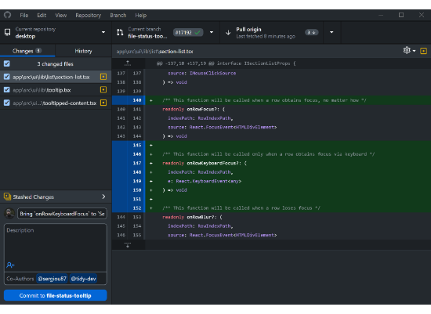

Bonus: GitHub Desktop
Visualizing Changes Made Simple
If the terminal feels intimidating, GitHub Desktop is the easiest way to manage your repos. It provides a GUI to visualize exactly what changed in every line of code.
View diffs (changes) side-by-side.
One-click commit and push.
Easy branch switching.

Slide 18
Section 04
Docker & Containers

Slide 19
What is Docker?
The Engine of Containerization
Docker is a containerization platform that packages an app with its code, runtime, libraries, and settings into one portable unit called a container.
docker
Consistent environments from laptop to production.
Lightweight containers that start in seconds.
Isolated processes that don’t conflict with each other.

Slide 20
Docker Architecture
Containers share the host OS kernel; virtual machines each carry their own
Containerized Applications
App A
App B
App C
App D
App E
App F
Docker
Host Operating System
Infrastructure
Virtual Machine Architecture
Docker Architecture
APP1
APP2
APP3
CONTAINER 1
CONTAINER 2
BINS/
LIBS
BINS/
LIBS
BINS/
LIBS
↓
↓
GUEST OS
GUEST OS
GUEST OS
APP1
BINS/LIBS
APP2
BINS/LIBS
HYPERVISOR
DOCKER ENGINE
HOST OS
HOST OS

Slide 21
How Docker Works
From Blueprint to Running App
Docker’s workflow moves through three building blocks that turn source code into a running app:
Dockerfile
Image
Container
Dockerfile: A blueprint of steps to build an image.
Image: A read-only snapshot built from the Dockerfile, ready to run.
Container: A live, running instance of an image, isolated and disposable.

Slide 22
The Essential Docker Command Manual
Command | Action | Context
docker build -t app . | Build an image from a Dockerfile | Creating the Image
docker run -d app | Start a new container from an image | Launching the App
docker ps | List all running containers | Checking Status
docker stop app | Gracefully stop a running container | Shutting Down
docker pull nginx | Download an image from Docker Hub | Fetching Images

Slide 23
Questions?
THANK YOU FOR YOUR TIME!

